Slide 1
Guide to Biological Literature
Notes:
One of the challenges in finding biological information is that very little of biological knowledge has been formalized. There are, of course, many databases out there that catalog biological data. However, none allow you perform abstract queries. For example, you can ask for a page describing the sequence and various properties of lambda repressor, but there is no database (yet) that allows you to express the query “give me all pairs of promoter and transcription factor in which the TF inhibits transcription of the promoter”. The deeper we go into the biochemistry, the worse the problem. So, today you’ll need to be able to do it the old-fashioned way…by reading. So, let me describe to you the biological literature as a roadmap.

Slide 2
Areas touched by synthetic biology
Non-biology areas sometimes crop up, but usually they answers you seek are going to be in a biology journal
Biology
Chemistry
Physics
Engineering
Notes:
Most of the literature relevant to synthetic biology is from the Biology domain. By that, I mean that most of it is accessible through pubmed, and you can query titles, authors, and abstracts for phrases of interest. There is some literature outside of biology that won’t be indexed in pubmed. This includes pure chemistry, physics and related math, and non-biological engineering topics.

Slide 3
General Audience Journals
Nature
Science
Cell
PLoS Biol
Proc Natl Acad Sci U S A. (PNAS)
PLoS One
Notes:
There is a short list of commonly-read general audience journals. The most prominent work is published in Nature, Science and Cell. Nature and Science are super-general in the sense that one article might be about antarctic nice and the next about photonic bandgap materials. Cell is specific to the bio domain, but is general within that domain. PNAS is broad-audience journal like Nature and Science. The PLoS journals are specific to bio but general within it.

Slide 4
Clinical Biology
JAMA
J Med Microbiol.
Jpn J Infect Dis.
Zh Mikrobiol Epidemiol Immunobiol.
Foodborne Pathog Dis.
Bosn J Basic Med Sci.
Zhongguo Dang Dai Er Ke Za Zhi.
Gastroenterology
Diagn Microbiol Infect Dis.
Notes:
There are a large number of clinical biology journals that deal with topics related to human health. You will frequently encounter these journals during your literature searches since they often are talking about bacterial things. However, they are rarely a source of useful data for genetic engineering. The one caveot to that would be around therapeutics and diagnostic applications where these journals may provide clinical evidence relevant to the problem at hand.

Slide 5
Synthetic Biology, Systems Biology
Established journals:
Journal of Biological Engineering (JBE)
Nucleic Acids Research (NAR)
Genome Research
New(ish) journals:
Molecular Systems Biology
ACS Synthetic Biology
Synthetic Biology
BMC Systems Biology
IET Synthetic Biology
Journal of Biomedical Science and Engineering (JBiSE)
Molecular BioSystems
Notes:
There are domain-specific journals where synthetic biologists publish work that isn’t of sufficient general interest to be in one of the broader-audience journals. Some, like JBE and NAR have been around for many years dealing with topics related to genetic engineering. In the past few years, there has been a proliferation of new Synthetic Biology journals. These are the journals where work is published, but rarely are these the papers that you will be going to when searching for biochemistry data. These tend to be ‘product’ or ‘tool’ papers, and it is very rare right now for syn biol people to publish ‘characterization’ papers.

Slide 6
Chemical Biology, Biorganic Chemistry, Protein Engineering
Chemistry and Biology
Nat Chem Biol.
J. Am. Chem. Soc. (JACS)
Angewandte Chemie International Ed.
Chembiochem
Notes:
For subjects that are more chemical, they will often go into a biological chemistry-oriented journal. Protein engineering and tricks associated with novel assays and chemistry tricks frequently appear in these journals. When searching for papers on issues of experimental design, these could have your answer. If you are looking for data about biochemistry, molecular biology, or cellular function, these are rarely your journals.

Slide 7
Biotechnology, Metabolic Engineering
Often these have useful stuff for ‘Part Mining’
Nature Biotechnology
Biotechnol Bioeng.
J Microbiol Biotechnol.
Appl Microbiol Biotechnol.
Appl Environ Microbiol.
Biosci Biotechnol Biochem.
Protein Expr Purif.
Lett Appl Microbiol.
Metab Eng.
Microb Cell Fact.
Notes:
Nature Biotech or NBT is currently the most prestigous ‘biotechnology’ journal. This class of journals deal with problem solving in the context of biological engineering. Synthetic Biology often appears in these journals. Very often your project will be based on some knowledge held in one of these journals, but they are rarely the raw source of biological knowledge.

Slide 8
Structural Biology
Often these help answer questions about specific proteins/RNAs
Acta Crystallogr Sect F Struct Biol Cryst Commun.
Acta Crystallogr D Biol Crystallogr.
Structure
Nat Struct Mol Biol.
Nat Struct Biol.
Biochim Biophys Acta.
J Phys Chem B.
Biophys J.
J Biomol Struct Dyn.
Many general audience journals have structural
biology sections
Notes:
Structural Biology journals deal with the three-dimensional structure of biomolecules. It is also very common for these papers to contain data about enzyme kinetics and other biochemical measurements. Also, they will very often contain data about gene expression, protein mutants and truncations. This can be an excellent source of biochemical knowledge, and an even better source for structures that enable protein engineering.

Slide 9
Biochemistry, Molecular Biology, Genetics
Often these have useful stuff for ‘Part Mining’
Biochemistry
Biochem J.
Biochem Soc Trans
Biochimie
Journal of Molecular Biology (JMB)
Gene
J Biol Chem. (JBC)
FEBS J.
Biochim Biophys Acta.
Insect Biochem Mol Biol.
Biochem Biophys Res Commun.
Eur J Biochem.
FASEB
Proteins
Mol Gen Genet.
Plasmid
FEBS J.
Proteins
Carbohydr Res.
Protein Sci.
RNA
EMBO J.
Notes:
The raw source for most biochemical data are the biochemistry, molecular biology, and genetics journals, of which there are many. These journals have been around for a long time and support a large community of biologists. Most synthetic biology projects have some relationship to papers in these journals. This is where ‘characterization’ data is most often presented.

Slide 10
Microbiology, Immunology, Microbial Pathogenesis, Virology
Often these have useful stuff for ‘Part Mining’
J Immunol
J Bacteriol.
J Microbiol.
Microbiology
Infect Immun.
Microbes Infect.
Cell Host Microbe.
Mikrobiologiia
Mol Microbiol.
J Clin Microbiol.
Microb Pathog.
Virology
Can J Microbiol.
FEMS Microbiol Lett.
Mol Plant Microbe Interact.
FEMS Microbiol Lett.
Notes:
For genetic elements that deal more with cellular function than molecular function, such as promoters, transcription factors, virulence factors, and so forth, the microbiology and immunology journals are usually where your search will lead. These fields intersect heavily with the biochemistry journals since microbiology is highly reductionist field – they try to tie observed cellular behavior down to the chemistry of what’s going on and the genes that encode that chemistry. These journals are a treasure trove of biochemical and microbiological data.

Slide 11
Search tools
Pubmed
http://www.ncbi.nlm.nih.gov/pubmed
Pubget
http://pubget.com/paper/18556020
(For retrieving PDFs directly, not searching. The #####’s are the PMID id)
Wikipedia
http://www.wikipedia.org/
Google Scholar
http://scholar.google.com/
Google Patents
http://www.google.com/patents
Google
http://www.google.com/
Notes:
A variety of search tools are available which index different bags of biologically-relevant documents. Pubmed indexes the abstracts, titles, authors, and affiliations of pretty much any paper relevant even loosely to biology. However, not all entries in pubmed link to the actual document. When there is no link, look for the ‘PMID’ number on the page. Pubget is a nice service that allows you to fetch the actual paper from its PMID. Wikipedia is an excellent resource for basic information on all sorts of subjects. Most common biologically-relevant chemicals, proteins, and genes have entries in wikipedia. Google Scholar indexes a similar bag of data to Pubmed but also includes the main body of the text. Searches that you might think to do in pubmed sometimes are better done in Scholar, but other times the larger scope leads to a lot of unrelated links. Google Patents allows you to do similar searches across the patent literature and is your best bet for accessing that space. An ordinary google search is also effective for biologically-related queries. There are many databases and ad hoc documents on the web containing useful knowledge. You just have to sift through a lot more unrelated stuff to find what you want.

Slide 12
How to find Biochemical Information
Notes:
Biochemical information exists at multiple levels of granularity. In coarse form, data about proteins and RNAs exists in various public databases on the internet. However, most of the info you want will require that you read papers.

Slide 13
Why are we focused on E. coli?
It’s the most studied organism (on earth)
The bulk of synthetic biology is done in E. coli
It’s much easier to find information here than in other cell types
Organisms almost undistinguishable from E. coli:
Citrobacter
Shigella
Salmonella
Enterobacteria highly similar to E. coli
Proteus
Serratia
Wigglesworthia
Yersinia
Generally, biochemical properties like expression and folding found in these other organisms extend to E. coli
Notes:
One of the reasons E. coli is so popular in genetic engineering is that everyone else is using E. coli. It has simply become a field standard prokaryote just as yeast is a standard simple eukaryote, and various human cell lines are standard models of the human system. Because others work with E. coli, there is a lot of information about people putting genes in this organism.
E. coli has some near phylogenetic neighbors like citrobacter, shigella, and salmonella. These organisms are almost indistinguishable from E. coli. These strains are as similar to your lab strain of E. coli as are the pathogenic strains of E. coli. Additional members of the enterobacteria ‘family’ include yersinia and serratia are similarly very similar to E. coli in terms of the housekeeping genes (ribosomes, replication factors, primary metabolic enzymes, etc.). Because of the similarity of these organisms, any information about the function of a gene is likely to carry over to your lab E. coli. This includes properties like gene expression and regulation of promoters.

Slide 14
Nomenclature conventions
Gene names in bacteria are written as
(lower case first letter, italicized text)
Proteins encoded by such genes are written as
(upper case first letter, not italicized)
geneX
GeneX
Notes:
By convention, prokaryotic genes are written in italics with the first letter lower case and all letters italicized.
Proteins encoded by those genes are written with the first letter capitalized and no italics.

Slide 15
Will my protein express in E. coli?
Most prokaryotic coding sequences will express in E. coli (unless toxic) if subcellular localization is preserved
50% of yeast or archaeal proteins express in E. coli (as long as they aren’t over ~1200 amino acids long or so)
Screening several homologs of a yeast/archael CDS often will identify one that can express in E. coli
Mammalian CDS’s have a much higher fail rate, often make inclusion bodies
Gene synthesizing a eukaryotic CDS with E. coli codon usage will often improve it’s ability to express, but not always.
Proper disulfide bonding is often a problem with proteins who are natively extracellular mammalian proteins
You’ll often find that proteins express or not in classes rather than as individuals, so evidence that one proteins does or doesn’t express is often evidence that a related protein will or will not express
Characterization of expression is likely to exist soon
Notes:
Not all genes will express in all cells.
Most prokaryotic coding sequences will express in E. coli (unless toxic) if subcellular localization is preserved
50% of yeast or archaeal proteins will express in E. coli (as long as they aren’t over ~1200 amino acids long or so)
If a gene fails to express, screening several (like 4) homologs of a yeast/archael CDS often will identify one that can express in E. coli. It is a property of a gene decoupled from its molecular function – it is about folding or stability.
Mammalian CDS’s, particularly for extracellular proteins, have a much higher fail rate, often make inclusion bodies
Gene synthesizing a eukaryotic CDS with E. coli codon usage will often improve it’s ability to express, but not always. The main culprit for poor expression is often the use of the rare arginine codons AGA and AGG.
Proper disulfide bonding is often a problem with proteins who are natively extracellular mammalian proteins
You’ll often find that proteins express or not in classes rather than as individuals, so evidence that one proteins does or doesn’t express is often evidence that a related protein will or will not express. For example, cytochrome 450 enzymes and polyketide megasynthases are infamous for not expressing well in E. coli.
Though a lot of reading must be done today to find out whether a gene can express, the ability to synthesize many genes and ask questions about their expression in multiple hosts now exists. There will likely be databases that house such information in the next two years. However, for now you must mine the literature for observations about expression, or test it yourself.

Slide 16
Will my protein express in E. coli?
The best evidence that a CDS will express is a paper in which someone expressed the protein in E. coli
Crystal structure papers and NMR papers are a great source for finding out if a protein expresses in E. coli
Be careful to check methods section and look out for buzzwords like “inclusion bodies” and “refolding” – that means it doesn’t express properly-folded protein
First try doing a pubmed structure search for the protein name, then read the paper
Pubmed keywords:
cloning Xyz
cloning Xyz
coli identification Xyz
coli Xyz expression
coli Xyz purification coli
Pubmed keywords:
structure Xyz
crystal Xyz
NMR Xyz
Notes:
The best evidence for expression is a direct observation. If you do queries such as ‘coli expression xyz’ you might find some papers. A popular journal title from the 80’s and 90’s was “Cloning and Expression of Xyz” and in those studies they did exactly what you are looking for.
<click>
Crystallography papers are a great source for this data since they had to produce and purify large amounts of material to do their experiment. Just read the methods and materials section of papers and look for the host organism. E. coli is the most convenient organism for protein purification, so if they did not use E. coli, there’s a good chance they tried that first and it didn’t work. However, if they were able to purify protein from E. coli, it must express just find.
<click>
One caveot to this inference is that sometimes people will overproduce a protein in E. coli, and it will accumulate, but it will be insoluble. The buzzwords here are ‘inclusion bodies’ and ‘refolding’ which means they didn’t actually express soluble protein.
<The best way to find papers of this sort is to do a pubmed structure search for the protein name, then find the materials and methods section of the paper associated with that structure. Often you can find papers about crystallization of a protein by searching pubmed for ‘crystal xyz’ or ‘structure xyz’ like queries.

Slide 17
Find an example of a catalase that can be used as a protein-coding part in E. coli
Catalase expression coli

Slide 18
Finding papers that describe gene expression
The best way is to identify information about transcriptional elements is searching for assay methods
Ideal reference: a plasmid with GFP and measured fluorescence under various conditions.
Most molecular biologists like to study gene expression in the genome to preserve the copy number and context to avoid artifacts
Searching pubmed for papers that describe the gene and one of the reporter genes might give such papers
Google searches will also scan the body of the papers for things, but is less efficient than the pubmed searches (you’ll get a lot of false positives). A paper that talks about specific details about an assay and the gene of interest can be pulled up this way.
Microarrays
RNA-Seq
lacZ assays
footprinting analyses
northern blots
western blots
Notes:
The best way is to identify information about transcriptional elements is searching for assay methods. Some of the buzzword experiments associated with gene expression are: Microarrays, RNA seq, lacZ assays, and so forth. So, you might search for “microarray coli radiation” to pull out papers that do some sort of microarray analysis on E. coli with and without radiation.
<click>
Your ideal situation is a paper in which the authors placed GFP behind a promoter on a plasmid and then measured fluorescence under various conditions. However, you won’t find that much of this experiment in the literature.
<click>
Most molecular biologists like to study gene expression in the genome to preserve the copy number and context to avoid artifacts. For such an experiment, lacZ is more popular than GFP because it is detectable at lower expression levels than is GFP.
<click>
Searching pubmed for things like “virF lacZ coli” will most likely pull up papers that study virF expression in E. coli using lacZ assays.
<click>
Google Scholar or vanilla google searches can be handy for these sorts of things. For example, authors might use lacZ in their experiment, but in the abstract not mention it or perhaps will call it a Miller assay or a galactosidase assay. Doing a full text query for ONPG (o-nitrophenylgalactoside), the substrate used in such an assay can sometimes pull up papers that you don’t get with “lacZ” as the search token.

Slide 19
Finding papers that describe gene expression
Search for the specific method along with the gene name or protein name
Google for words associated with the experiment along with the gene name or protein name
Going the other direction, you can do similar searches starting with phrases about the induction conditions and search for gene names associated with it
Can also search for verbs like induction, activation, repression, control, regulation
Xyz GFP
Xyz lacZ
Xyz phoA
Xyz alkaline phosphatase
Xyz microarray
Xyz northern
Xyz western
miller Xyz
ONPG Xyz
Notes:
If you are searching for things by specific method, your queries would look like: Xyz + GFP, lacZ, phoA, alkaline phosphatase, microarray, northern, or western.
<click>
If you want to use words associated with an experiment, then you might try miller or ONPG.
<click>
In all the cases thus far, I am dealing with situtation in which you know the name of the gene you care about and want to find out about its regulation. This is the easier direction, and some of this data is already cataloged in places like RegulonDB. The other direction is more challenging – here you have a condition and you want to know genes that are affected by it. For example, let’s say you want to find promoters in E. coli that are activated during anaerobic growth. Here, you’d replace the gene name with the condition name, so “anaerobic coli miller” would pull up things you want.
<click>
If what you care about is more abstract, things get challenging. Suppose you want to find any combination of transcription factor and a promoter is activates. You can try searching for “promoter transcription factor activation” and you’ll pull up interesting things, but there is currently no way of efficiently performing this type of query.

Slide 20
Find a promoter controlled by VirF in shigella
Google: virF activation lacZ shigella

Slide 21
Pathway Identification
Notes:
Let’s say you want to make a chemical in E. coli or yeast. The first question to ask is whether you know of any enzymatic pathway from a native metabolite to the product of interest. This is the pathway identification problem.

Slide 22

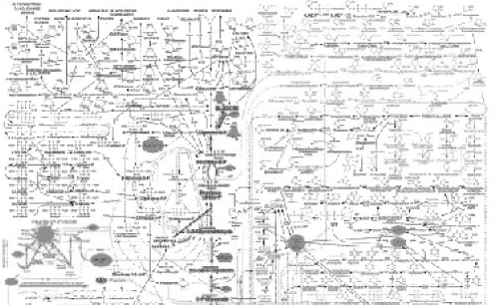

Design Synthesis
+
+
A Chassis Organism
The Metagenome
Target Activity
tyrB
papA
papB
papC
A Concrete Device
Notes:
The design synthesis problem in synthetic biology is akin to retrosynthetic analysis in chemistry, or design synthesis in the area of electronic engineering, and looks a lot like “program synthesis” in computer science. For a chemical or activity that is already existent in nature, this is fairly straightforward – just look up the paper that describes it and build that.

Slide 23
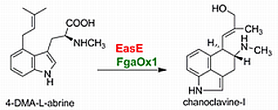
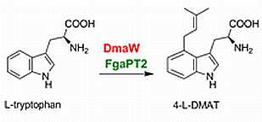
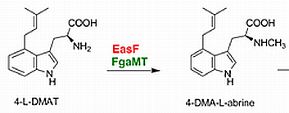
Reachability
Notes:
Suppose I have a large set of reactions that I know will spontaneously occur with the right enzyme and the right cofactors. How do I determine whether a chosen set of these enzymes will produce the desired product in a given cell? First, let’s abstract these chemicals to A, B, C, and D to simplify this to just the logic without reference to structure.

Slide 24
Reachability
A
B
C
D
C
D
A
B
If all substrates and cofactors are reachable, then the products of the reaction are reachable
B
C
Notes:
Provided any specific chemical, how do I know whether it can be reached by biosynthesis? If the chemical isn’t present in any of the reactions, I have no basis for thinking it can be reached, so I should discard it. Our bag of reactions here only contains A, B, C, and D, so we can only consider those. Suppose we choose D. We see that *click* C can be converted to D, so if C is reachable we can get to D. We also see that C is reachable *click* if we can get to B, and B is *click* reachable if we can get to A. We can’t trace back from A any further through this data, but if A is already in the cell, then we should be able to make B, C, and/or D by adding the appropriate enzymes. In short, we can define the reachability of a chemical by moving backwards through a bag of biochemical data and determining whether the reactants for each reaction are also reachable. *click* If all substrates and cofactors for a reaction are reachable, then the products of the reaction are reachable.

Slide 25
Reachability
A
B
C
D
C
D
A
B
If all substrates and cofactors are reachable, then the products of the reaction are reachable
B
C
Notes:
This simple logic takes you pretty far in biosynthesis, but it’s not quite perfect. First, the enzymes not only have to do the reaction, but they have to express and fold properly within your cell. Also, if the cell dies because there is a toxic intermediate in your pathway, then the product isn’t going to be produced. We also haven’t considered the effects of the other enzymes in the cell on these intermediates, the potential for our added enzymes to be postranslationally affected by other metabolites. Finally, this all makes a really bad simplifying assumption about enzymes – that they only have one substrate. Just because an enzyme has never been observed to do a particular reaction, that does not mean it is unable to perform it. Because of this, this enumeration strategy will necessarily underpredict the actual list of reachable chemicals. Additionally, it will underpredict the unanticipated side reactions that will occur. With all those caveots stated, this basic logic is the a good ‘first step’ that gives rise to experimentally-verifiable predictions.

Slide 26
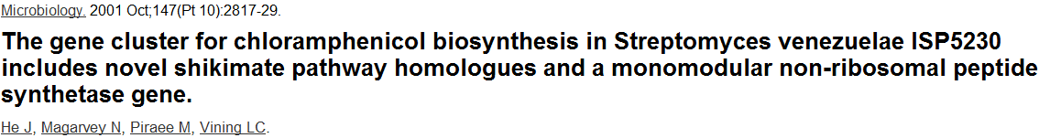
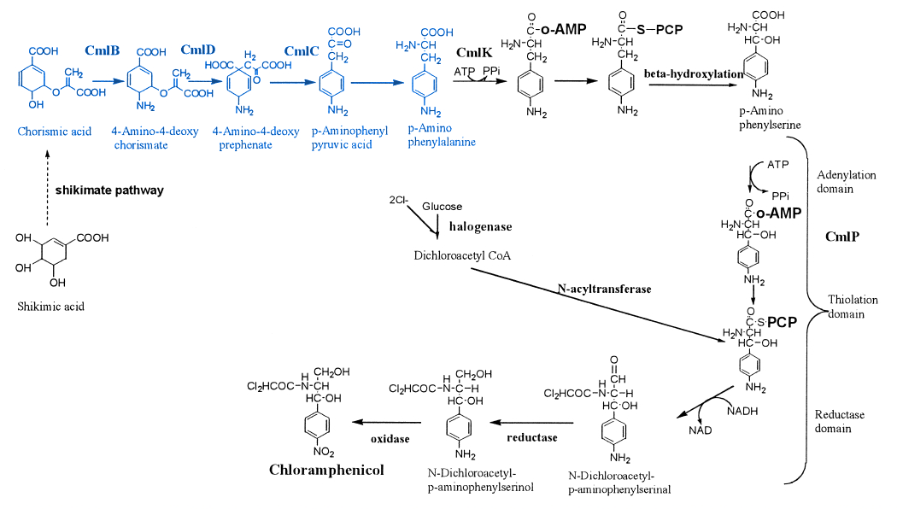
Notes:
Let’s look at a specific example so that you can see some examples of the complexity that you will run into in doing pathway identification. Shown here is the biosynthetic pathway for chloramphenicol in Streptomyces venezuelae. Within that reaction sequence is the intermediate p-amino phenylalanine. Suppose we wish to make that substance in E. coli. You’ll notice *click* that the route from shikimate, a molecule in all cells, to 4-aminophenyl pyruvic acid, is all worked out in the system *click*.
The last step in which the alpha keto acid is transaminated to the amino acid is not explicitly stated.

Slide 27
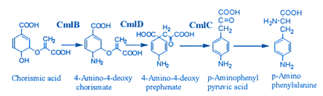
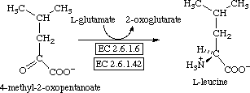
P-Amino Phenylalanine Reachability
Transaminases of E. coli:
aspC
ilvE
tyrB
Notes:
Suppose we had the CmlB, CmlD, and CmlC reactions enumerated in our bag of data. We know that E. coli does indeed make chorismic acid and all the cofactors required for this series of reactions. Is P-Amino Phenylalanine reachable? Logic would say no, but experience says yes. If we could just do the last step, yes, it would be reachable, but that reaction isn’t observed to occur anywhere in E. coli because the p-aminophenyl pyruvic acid intermediate is not spontaneously made in E. coli. E. coli does, however, make 20 proteinogenic amino acids. It does a very similar last step, transamination for all these amino acids, and it does so with only 3 enzymes AspC, IlvE, and TyrB. In fact, our substrate looks a lot like the precursor to tyrosine – they differ only by replacing the para hyroxyl group with an amino group. Perhaps the enzyme that transaminates tyrosine (which is TyrB) will also accept our p-amino variant.

Slide 28
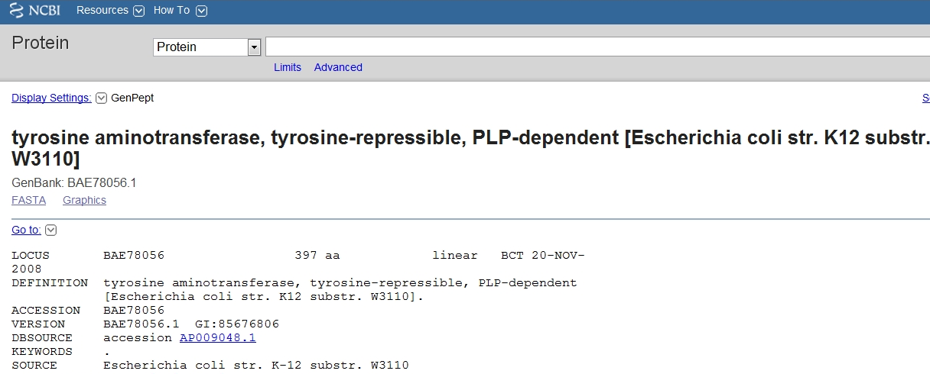
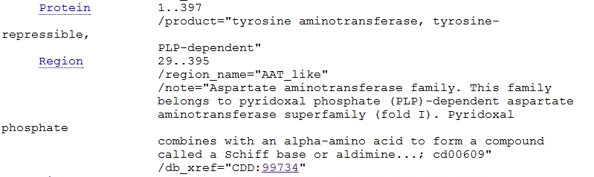
The world of E. coli TyrB
(According to NCBI)
Notes:
If we go reading about TyrB, we’ll find all sorts of database entries describing that TyrB likes the tyrosine intermediate. Here is it’s pubmed entry – we can get sequence info for it in a great many organisms.

Slide 29
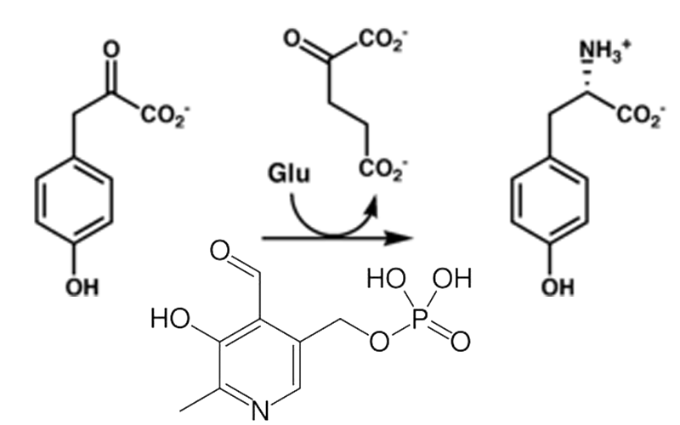
The world of E. coli TyrB
(According to NCBI)
?
TyrB
“Sequence-wise, it looks like other aminotransferases”
Notes:
We can interpret the information that it likes the Tyr precursor, and that it likes a PLP cofactor.

Slide 30
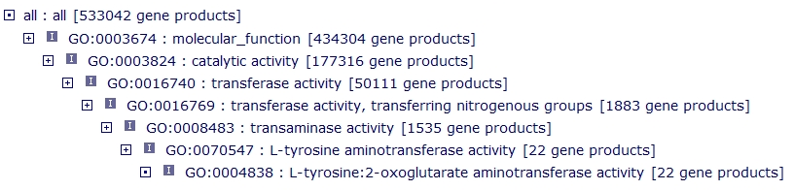
The world of E. coli TyrB
(According to the GO Ontology Molecular Function)
From http://amigo.geneontology.org/cgi-bin/amigo/gp-assoc.cgi?gp=EcoCyc:TYRB-MONOMER&session_id=7828amigo1314671249 GO:0008793 : aromatic-amino-acid:2-oxoglutarate aminotransferase activity
GO:0050048 : L-leucine:2-oxoglutarate aminotransferase activity
GO:0004838 : L-tyrosine:2-oxoglutarate aminotransferase activity
GO:0005515 : protein binding
GO:0042803 : protein homodimerization activity
GO:0030170 : pyridoxal phosphate binding
Zoom in from http://amigo.geneontology.org/cgi-bin/amigo/browse.cgi?action=set-tree&term=GO:0004838&session_id=7828amigo1314671249
Notes:
We can find ontologies that also describe this behavior, but nothing specific about p-amino phe.

Slide 31
The world according to E. coli TyrB
(According to KEGG and BRENDA)
According to KEGG:
According to BRENDA:
Has a description for the EC:2.6.1.57 class:
http://www.brenda-enzymes.org/php/result_flat.php4?ecno=2.6.1.57
The E. coli instance includes as substrates:
Tyrosine, Tryptophan, 3-iodo-L-tyrosine, leucine,
methionine “weak activity”, and phenylalanine
It also has K_{cat}/K_{m} values for some of those amino acids
Notes:
KEGG similarly doesn’t get past describing the natural role of the enzyme. BRENDA comes close – this database enumerates everything that a group of scientists could extract out of databases. They see that it likes Tyr, Trp, 3-iodo-tyr, leu, met, and Phe. It also has kinetic data for some amino acids, but nowhere in here is anything about p-Amino Phe.

Slide 32
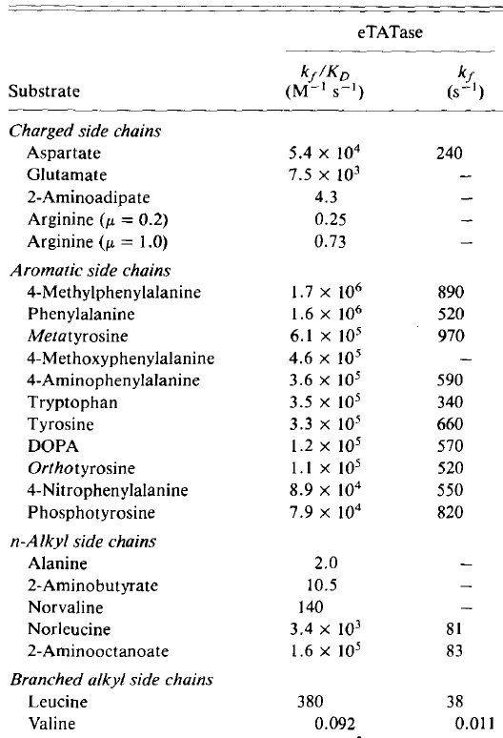
The world according to E. coli TyrB
(According to papers)
The specificity is very broad
These specificities manifest themselves as different Kcat/Km-like values; it’s not a binary thing though most “other” reactions will be undetectable
Databases don’t currently capture all this information (but BRENDA comes close)
From PMID: 8528072
Notes:
If you start digging into papers about TyrB, you’ll find some more anecdotal or non-extractable knowledge. For example, TyrB even likes isoleucine as a substrate – it takes pretty much any alpha keto acid that is a little greasy.
*click*
It’s specificity is very broad
*click*
These specificities manifest themselves as different Kcat/Km values. It’s not a boolean thing though most other reactions will be undetectable.
*click*
Databases don’t currently capture this information. It is, in my view, the primary error in our modeling of biochemical systems that prevents us from making fine-grained predictions about what will happen when we add genes to cells. Fortunately, tools and technologies for addressing this problem are under active development.

Slide 33
Design Challenges I:
MCF Organisms

Slide 34
Format for design challenges
You will work in teams for around 3 weeks on each challenge, so we’ll do 4 of them
You will have Friday class times to work on this, and occasionally others
You will likely need to work on this outside of class time as well
The final deliverable for each challenge is a Powerpoint presentation each 3rd friday

Slide 35
Your presentations:
Powerpoint format
You’ll have around 10 min to present
We’ll do them during both periods on each terminal Friday
You are presenting in a group, ideally individuals would speak about the topics they spent time researching
You should send your ppt to Chris Eiben for posting to the group on BSpace

Slide 36
First Challenge
The Reachability definition described today can be encoded as an algorithm and used to exhaustively calculate all concretely reachable chemicals. For this challenge, I provide you a short list of reachable chemicals.
Your team must read about the chemicals and choose one that you consider to be viable for production at scale. Your choice of target and justification for going after it should be clearly explained and be reasonable. You must trace through the databases to identify a set of genes that should work in E. coli to produce the product. Finally, you should design one or more genetic constructs that will produce this chemical.
The targets are on bspace as “Challenge 1 targets.xlsx”
As individuals, google these chemicals, and find a short list of interesting ones for next Friday.

